Slide 1
Multiplayer Reach-Avoid Games
Mo Chen, Zhengyuan Zhou, and Claire Tomlin

Slide 2
Outline
Multiplayer Reach-Avoid Game
Path defense problem
Reach-avoid via path defense
Numerical Implementation/Simulations along the way
Conclusion

Slide 3
Outline
Multiplayer Reach-Avoid Game
Path defense problem
Reach-avoid via path defense
Conclusion

Slide 4
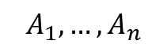
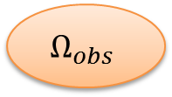
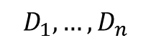

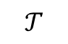
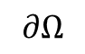
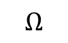
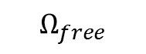
Multiplayer Reach-Avoid Game
= target
= defender
= attacker
= obstacles
$$∂Ω$$
$$Ω_{free}$$
$$D_{1},…,D_{n}$$
$$Ω_{obs}$$
$$Ω$$
$$𝒯$$
$$A_{1},…,A_{n}$$
$$Ω_{obs}$$

Slide 5
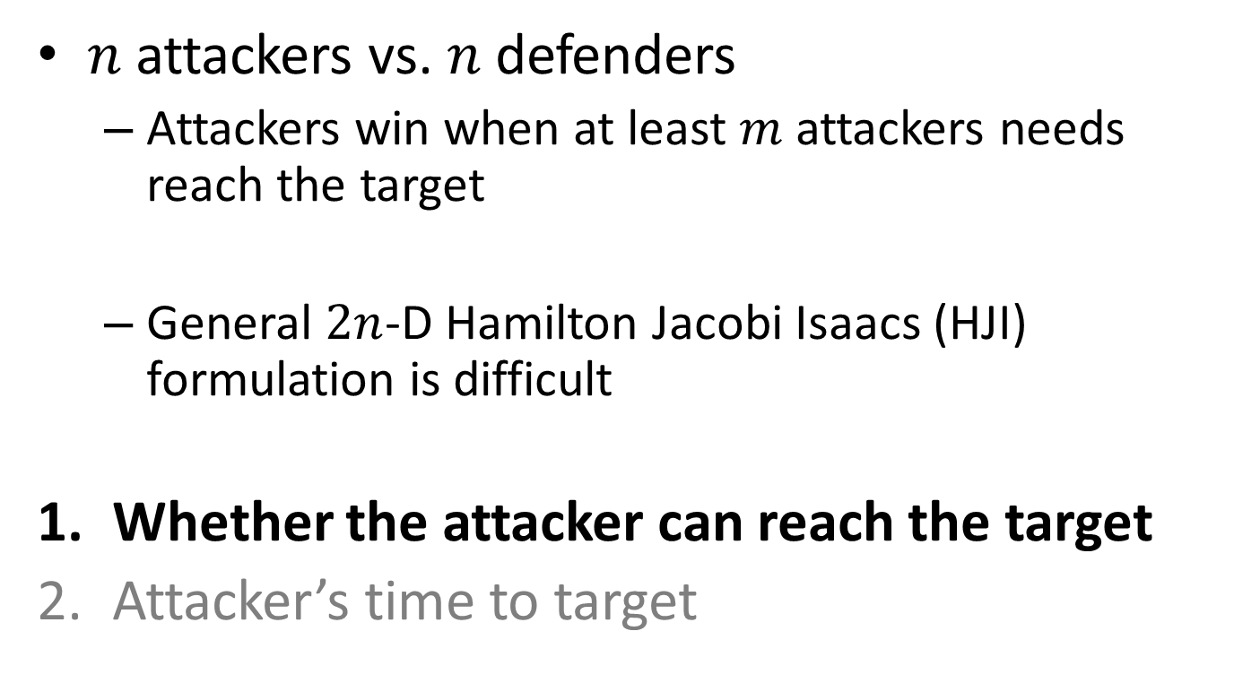
Multiplayer Reach-Avoid Game
$n$ attackers vs. $n$ defenders
Attackers win when at least $m$ attackers needs reach the target
General $2n$-D Hamilton Jacobi Isaacs (HJI) formulation is difficult
Whether the attacker can reach the target
Attacker’s time to target

Slide 6
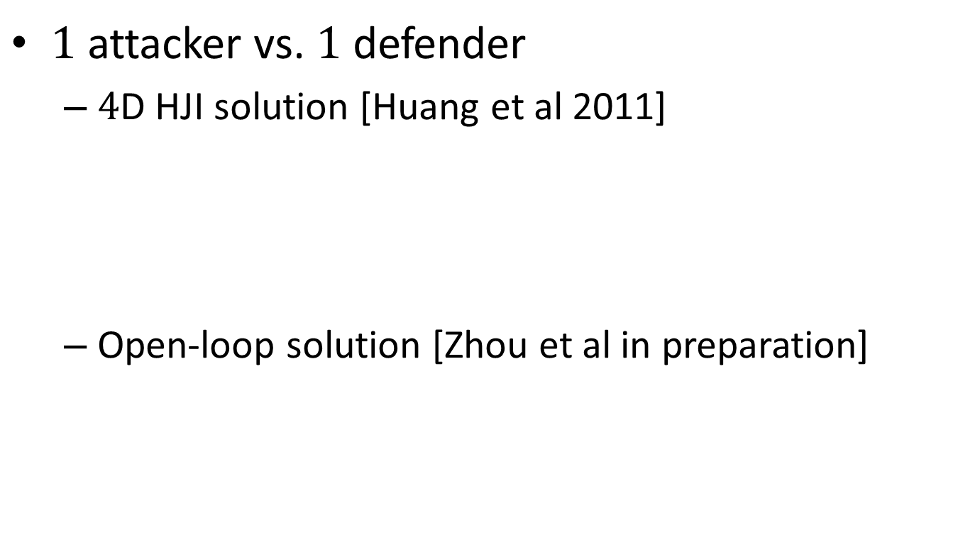
Two Player Game
$1$ attacker vs. $1$ defender
$4$D HJI solution [Huang et al 2011]
Open-loop solution [Zhou et al in preparation]

Slide 7
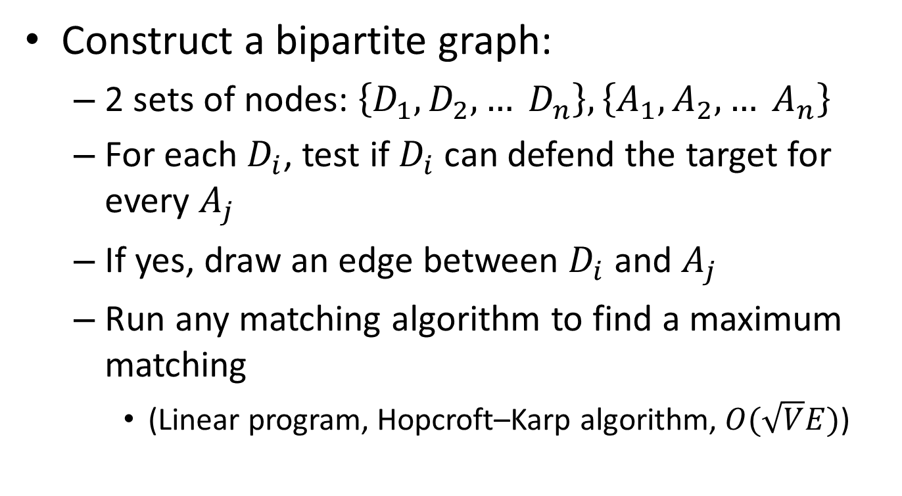
From Two Player to Multiplayer
Construct a bipartite graph:
2 sets of nodes: $\left\{D_{1}, D_{2}, … D_{n}\right\},\left\{A_{1},A_{2},… A_{n}\right\}$
For each $D_{i}$, test if $D_{i}$ can defend the target for every $A_{j}$
If yes, draw an edge between $D_{i}$ and $A_{j}$
Run any matching algorithm to find a maximum matching
(Linear program, Hopcroft–Karp algorithm, $O(\sqrt{V}E)$)

Slide 8
From Two Player to Multiplayer
= target
= defender
= attacker
= obstacles

Slide 9
From Two Player to Multiplayer
= target
= defender
= attacker
= obstacles

Slide 10
From Two Player to Multiplayer
= target
= defender
= attacker
= obstacles

Slide 11
From Two Player to Multiplayer
= target
= defender
= attacker
= obstacles

Slide 12
From Two Player to Multiplayer
= target
= defender
= attacker
= obstacles

Slide 13
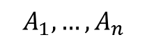
Multiplayer Complexity Reduction
$2n$-D HJI
$n^{2}$ $4$-D HJI

Slide 14
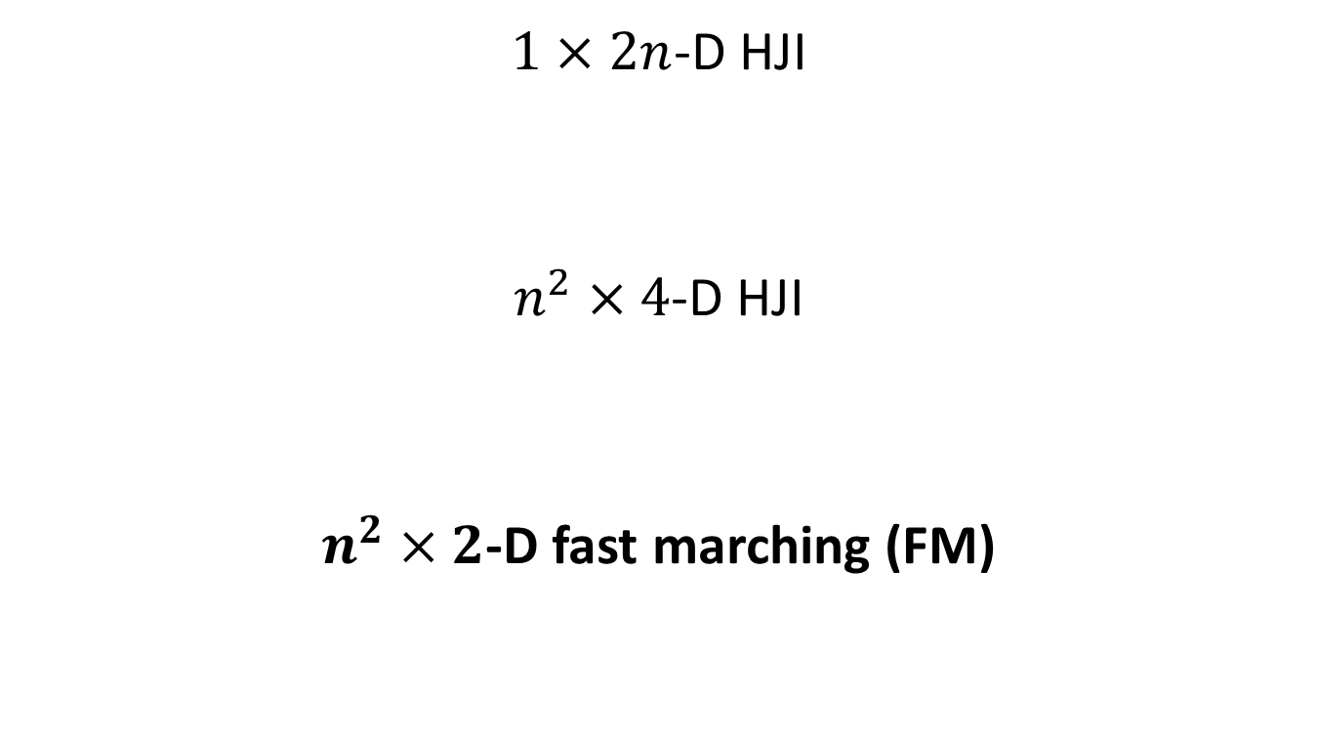
Multiplayer Complexity Reduction
$1×2n$-D HJI
$n^{2}×$ $4$-D HJI
$n^{2}×$ $2$-D fast marching (FM)

Slide 15
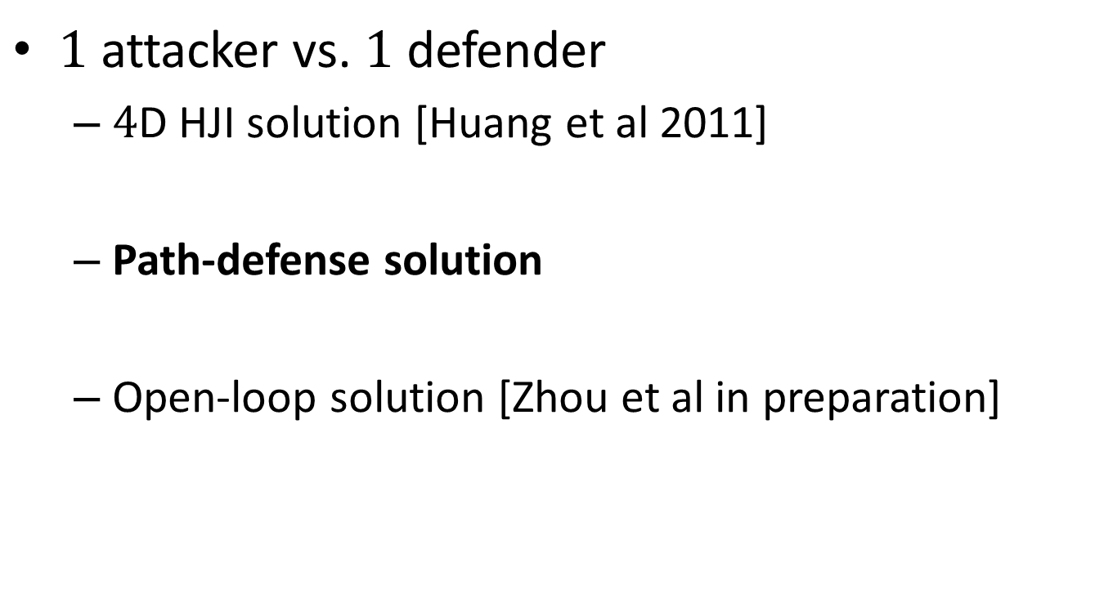
Two Player Game
$1$ attacker vs. $1$ defender
$4$D HJI solution [Huang et al 2011]
Path-defense solution
Open-loop solution [Zhou et al in preparation]

Slide 16
Outline
Multiplayer Reach-Avoid Game
Path defense problem
Reach-avoid via path defense
Conclusion

Slide 17
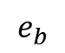

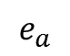
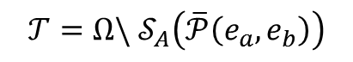
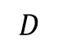
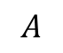
Path Defense, a Special Target Set
$$e_{a}$$
= target
= defender
= attacker
$$D$$
$$𝒯=Ω\backslash 𝒮_{A}\left(\overline{𝒫}\left(e_{a},e_{b}\right)\right)$$
$$𝒮_{A}\left(\overline{𝒫}\left(e_{a},e_{b}\right)\right)$$
$$A$$
$$e_{b}$$

Slide 18
Strong Path Defense
Defender must be on the path after finite time

Slide 19
Strong Path Defense
Defender must be on the path after finite time
A defendable path that’s not strongly defendable:
= defender
= attacker
= Voronoi line

Slide 20
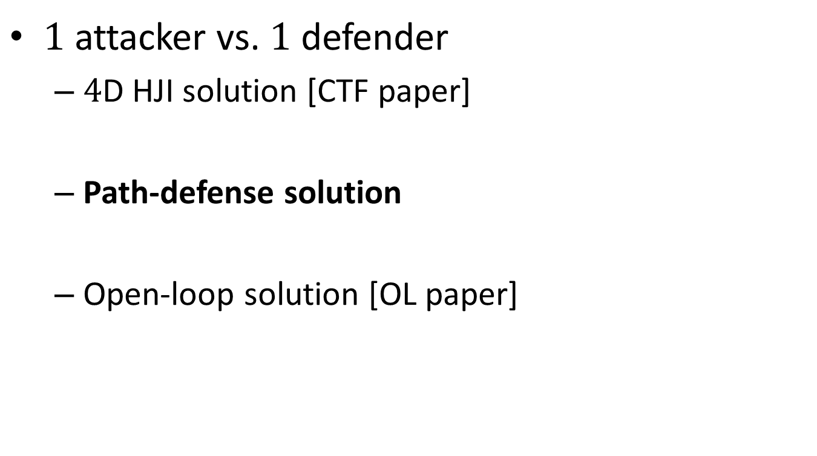
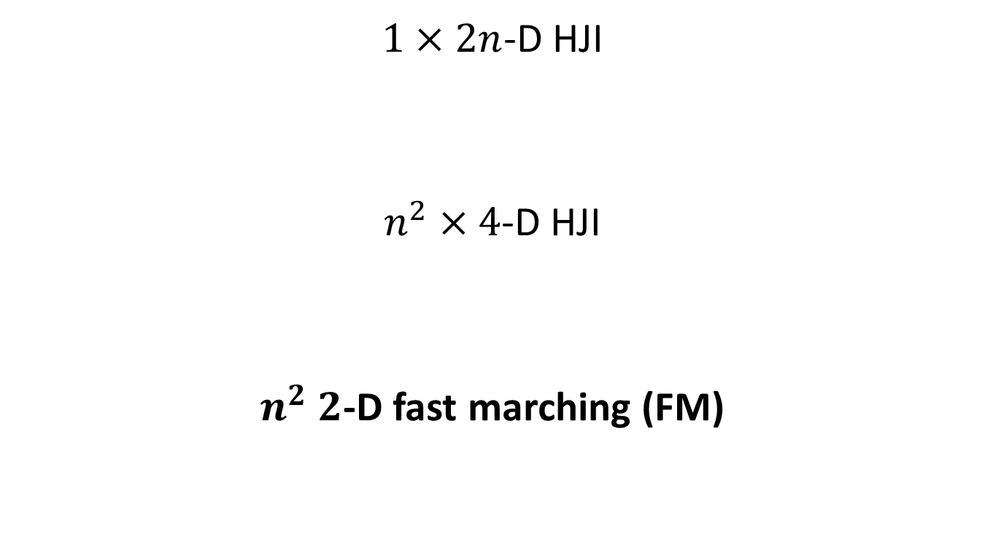
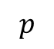
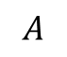
Strong Path Defense
$$e_{a}$$
= target
= attacker
= attacker’s level set image
= defender’s arrival point
$$p$$
$$A$$
$$e_{b}$$

Slide 21
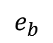
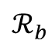
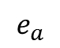
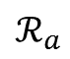
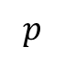
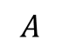
Strong Path Defense
$$e_{a}$$
= target
= attacker
= attacker’s level set image
= defender’s arrival point
$$ℛ_{a}$$
$$p$$
$$A$$
$$ℛ_{b}$$
$$e_{b}$$

Slide 22
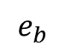
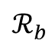
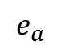
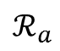
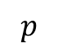
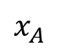
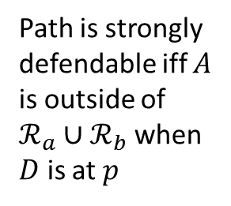
Strong Path Defense
$$e_{a}$$
= target
= attacker
= attacker’s level set image
= defender’s arrival point
$$ℛ_{a}$$
$$p$$
$$x_{A}$$
Path is strongly defendable iff $A$ is outside of $ℛ_{a}∪ℛ_{b}$ when $D$ is at $p$
$$ℛ_{b}$$
$$e_{b}$$

Slide 23
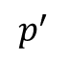
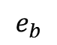
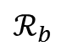
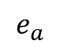
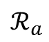
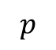
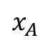
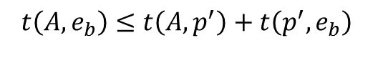
Strong Path Defense
$$e_{a}$$
= target
= attacker
= defender’s arrival point
= attacker’s crossing point
$$ℛ_{a}$$
$$p$$
$$p^{′}$$
$$t\left(A,e_{b}\right)≤t\left(A,p^{′}\right)+t\left(p^{′},e_{b}\right)$$
$$ℛ_{b}$$
$$e_{b}$$
$$x_{A}$$

Slide 24
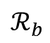
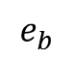
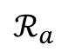
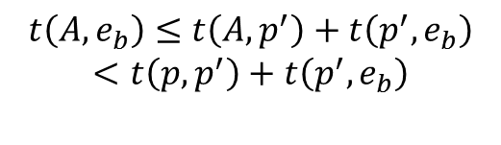
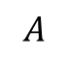
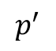
Strong Path Defense
$$e_{a}$$
= target
= attacker
= defender’s arrival point
= attacker’s crossing point
$$ℛ_{a}$$
$$p$$
$$p^{′}$$
$$t\left(A,e_{b}\right)≤t\left(A,p^{′}\right)+t\left(p^{′},e_{b}\right)$$
$$<t\left(p,p^{′}\right)+t\left(p^{′},e_{b}\right)$$
$$ℛ_{b}$$
$$e_{b}$$
$$A$$

Slide 25
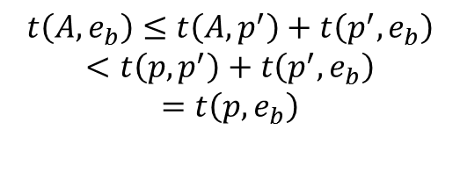
Strong Path Defense
$$e_{a}$$
= target
= attacker
= defender’s arrival point
= attacker’s crossing point
$$ℛ_{a}$$
$$p$$
$$p^{′}$$
$$t\left(A,e_{b}\right)≤t\left(A,p^{′}\right)+t\left(p^{′},e_{b}\right)$$
$$<t\left(p,p^{′}\right)+t\left(p^{′},e_{b}\right)$$
$$=t\left(p,e_{b}\right)$$
$$ℛ_{b}$$
$$e_{b}$$
$$A$$

Slide 26






Strong Path Defense
$$e_{a}$$
= target
= attacker
= defender’s arrival point
= attacker’s crossing point
$$ℛ_{a}$$
$$p$$
$$p^{′}$$
$$t\left(A,e_{b}\right)≤t\left(A,p^{′}\right)+t\left(p^{′},e_{b}\right)$$
$$<t\left(p,p^{′}\right)+t\left(p^{′},e_{b}\right)$$
$$=t\left(p,e_{b}\right)$$
$$<t\left(A,e_{b}\right)$$
$$ℛ_{b}$$
$$e_{b}$$
$$x_{A}$$

Slide 27

Strong Path Defense
Naïve idea: Check every point $p$ on the path
Clever idea: Check the best point $p^{∗}$
$A$ is equidistant to $ℛ_{a}$ and $ℛ_{b}$

Slide 28


Strong Path Defense
= target
= defender
= attacker
= best point of arrival
$$D$$
$$p^{∗}$$

Slide 29


Strong Path Defense
= target
= defender
= attacker
= best point of arrival
= candidate best point
$$D$$
$$p^{∗}$$
$$p$$
$$t\left(D,p^{∗}\right)≤t\left(D,p\right)+t\left(p,p^{∗}\right)$$

Slide 30





Strong Path Defense
$$e_{a}$$
= target
= defender
= attacker
= best point of arrival
= candidate best point
$$x_{D}$$
$$p^{∗}$$
$$p$$
$$ℛ_{a}$$
$$x_{A}$$
$$e_{b}$$
$$ℛ_{b}$$
$$t\left(D,p^{∗}\right)≤t\left(D,p\right)+t\left(p,p^{∗}\right)$$
$$t\left(D,p^{∗}\right)−t\left(D,p\right)≤t\left(p,p^{∗}\right)$$

Slide 31



Strong Path Defense
= target
= defender winning region
= attacker
= best point of arrival
$$p^{∗}$$
$$𝒢$$
$$x_{A}$$

Slide 32

Strong Path Defense
Algorithm for checking if a path is strongly defendable:
Run FM from $A$
Compute $R_{a},R_{b}$: Run FM from $e_{a}$ and $e_{b}$
Compute $p^{∗}$:
$$t\left(e_{a},e_{b}\right)=t\left(A,e_{a}\right)−t\left(A,R_{a}\right)+t\left(A,e_{b}\right)−t\left(A,R_{b}\right)$$
$$2t\left(A,R\right)=t\left(A,e_{a}\right)+t\left(A,e_{b}\right)−t\left(e_{a},e_{b}\right)$$
Compare $t\left(A,R\right)$ and $t\left(D,p^{∗}\right)$ / Run FM from $p^{∗}$

Slide 33
Conservatism of Strong Path Defense
What paths are defendable but not strongly defendable?
= defender
= attacker
= Initial Voronoi line

Slide 34



Conservatism of Strong Path Defense
What paths are defendable but not strongly defendable?
= defender
= attacker
= Voronoi line
$$p$$
$$x_{A}$$
$$x_{D}$$

Slide 35
Conservatism of Strong Path Defense
What paths are defendable but not strongly defendable?
= defender
= attacker
= Voronoi line

Slide 36
Conservatism of Strong Path Defense
What paths are defendable but not strongly defendable?
= defender
= attacker
= Voronoi line

Slide 37
Conservatism of Strong Path Defense
What paths are defendable but not strongly defendable?
= defender
= attacker
= Voronoi line

Slide 38
Conservatism of Strong Path Defense
What paths are defendable but not strongly defendable?
= defender
= attacker
= Voronoi line

Slide 39

200 by 200 grid
83.4% of voronoi area is defendable

Slide 40

200 by 200 grid
79.3% of voronoi area is defendable

Slide 41

200 by 200 grid
83.2% of voronoi area is defendable

Slide 42
Outline
Multiplayer Reach-Avoid Game
Path defense problem
Reach-avoid via path defense
Conclusion

Slide 43
Convex Domain
Defender wins iff target is contained in Voronoi region
= target
= defender
= attacker
= Voronoi line

Slide 44
Convex Domain
Defender wins iff target is contained in Voronoi region
= target
= defender
= attacker
= Voronoi line

Slide 45
Non-convex domain
= target
= defender
= attacker
= Voronoi line

Slide 46






Non-convex domain
$$e_{a}$$
= target
= defender
= attacker
= Voronoi line
$$x_{A}$$
$$c$$
$$e_{b}$$
$$e_{c}$$
$$x_{D}$$

Slide 47
Non-convex domain
Naïve path defense solution: check all paths to find one that is strongly defendable
= target
= defender
= attacker
= path of defense

Slide 48
Non-convex domain
Check strong defendability for paths touching the target
= target
= defender
= attacker
= path of defense

Slide 49

Shortest path touching target
Algorithm: how to find shortest path touching target
Pick a point on $∂Ω$, run FM
Run FM with target as obstacle
Determine other end points on $∂Ω$ from difference of 1. and 2.

Slide 50

Shortest path touching target

Slide 51

Shortest path touching target
1
2
3

Slide 52

Shortest path touching target
Algorithm: how to find shortest path touching target
Pick a point on $∂Ω$, run FM
Run FM with target as obstacle
Determine other end points on $∂Ω$ from difference of 1. and 2.
Choose the path that the attacker must cross to reach the target

Slide 53

2 player reach-avoid via path defense
Algorithm for determining whether the attacker can reach the target
Pick a point on the boundary $∂Ω$, find the shortest path touching target
Check if this path is strongly defendable
Repeat until a strongly defendable path is found or until all paths have been checked

Slide 54


200 by 200 grid

Slide 55

200 by 200 grid

Slide 56

200 by 200 grid

Slide 57

Multiplayer

Slide 58

Multiplayer
At least $m$ attackers reach the target
Maximum matching should be size at least $n−m+1$

Slide 59

Back to two players: Delaying the Attacker
Whether the attacker can reach the target
Attacker’s time to target
$=∞$ if target is (strongly) defendable

Slide 60

Delaying the Attacker
Open-loop solution
Positive capture radius acts as an obstacle to delay the attacker

Slide 61
Delaying the Attacker
Path-defense solution
0 capture radius
Closed-loop strategy on a path of defense induces an obstacle to delay the attacker

Slide 62
Delaying the Attacker

Slide 63





Delaying the Attacker
$$A$$
$$t\left(A,r\right)=t\left(D,p\right)+t\left(p,r\right)$$
$$p$$
$$r$$
$$D$$

Slide 64



Slide 65



Delaying the Attacker: Multiple defenders
$$A$$
$$D_{1}$$
$$D_{2}$$

Slide 66
Future Work
Faster attacker
Capture radius
Incorporating More Complex Dynamics (Reeds-Shepp Car, Dubin’s Car)
Cooperation between defenders(i.e. what if no suitable matching exists?)
Imbalanced team with more attackers than defenders
Suggestions? + Many many more…

Slide 67
Acknowledgements
Zhengyuan for intriguing discussions
Lucretia for creating figures
Claire for support and guidance

Slide 68


= defender
= attacker
= path of defense
$$𝒫_{i}$$
$$𝒫_{j}$$

